Slide 1


Slide 2
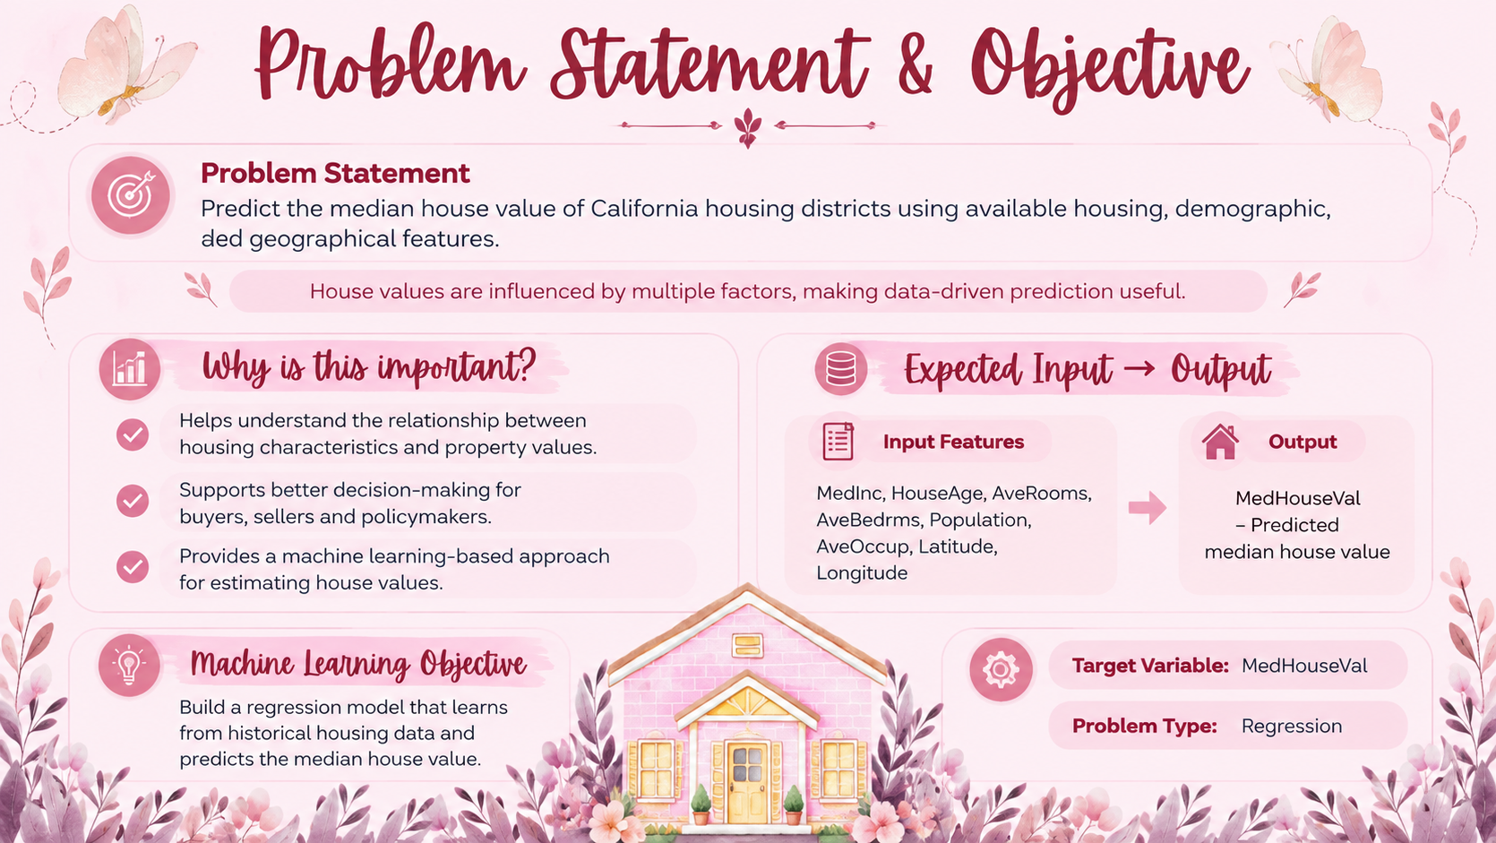
&

Slide 3
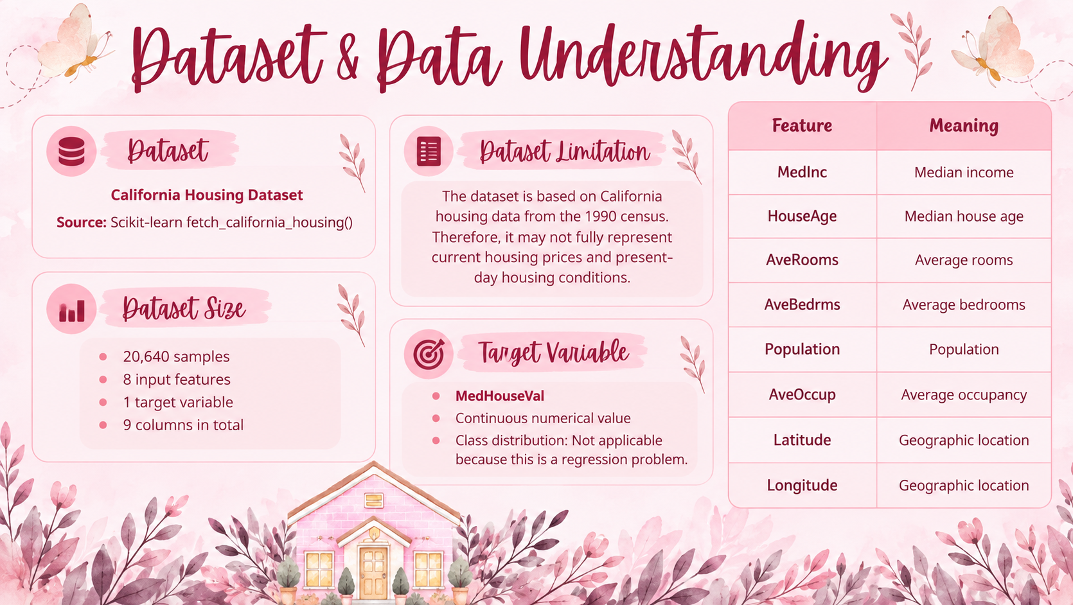

Slide 4
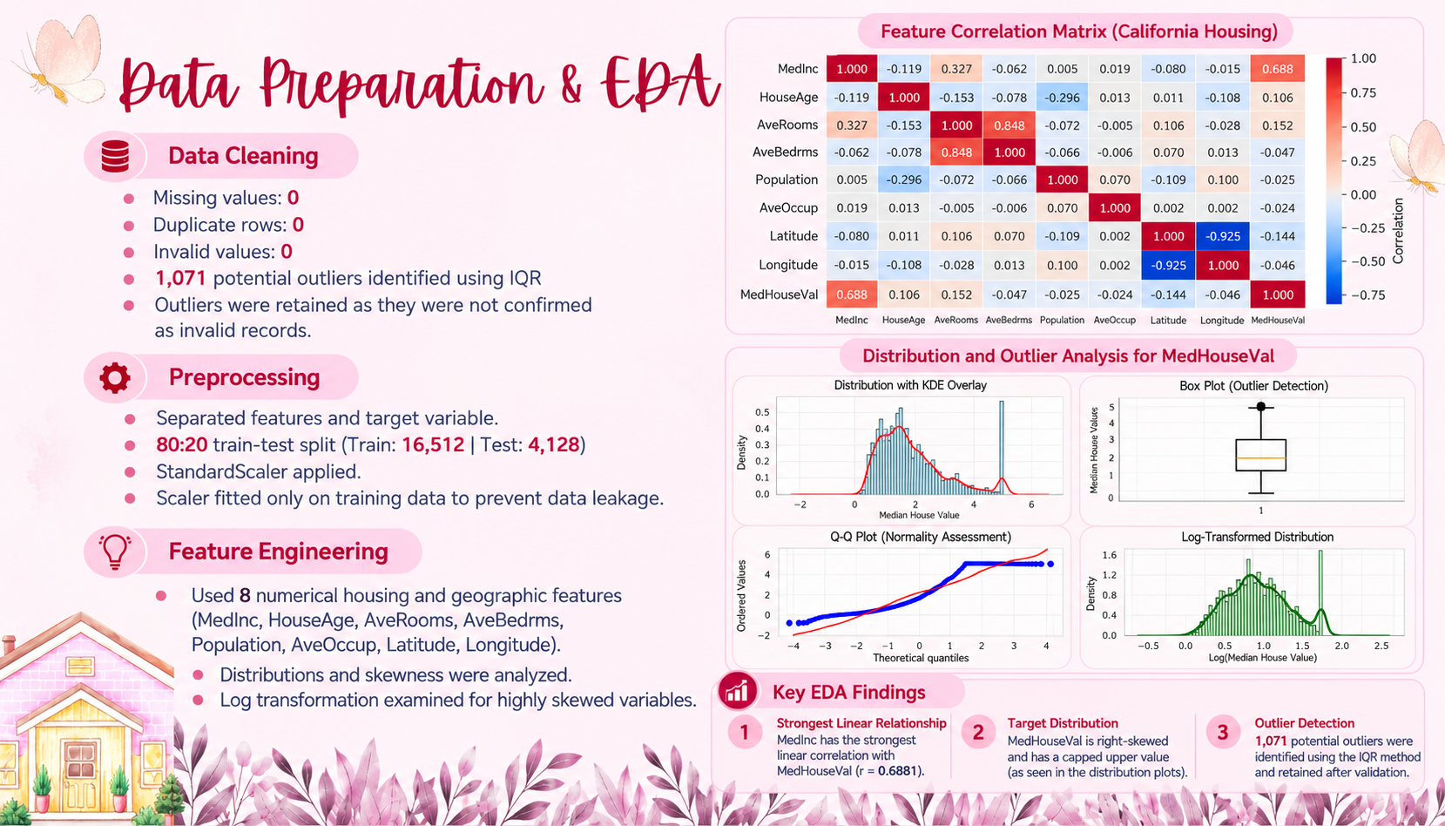

Slide 5

Machine Learning Approach
ALGORITHMS USED
BASELINE (MEAN)
LINEAR REGRESSION RIDGE REGRESSION DECISION TREE
RANDOM FOREST
LIGHTGBM
XGBOOST

Slide 6
WHY THESE MODELS WERE SELECTED
SPAN THE BIAS-VARIANCE SPECTRUM, NOT PICKED ARBITRARILY
BASELINE = FLOOR EVERY MODEL MUST BEAT
LINEAR/RIDGE = TEST IF THE RELATIONSHIP IS SIMPLE/LINEAR
DECISION TREE = SHOWS THE OVERFITTING FAILURE MODE
RANDOM FOREST, LIGHTGBM, XGBOOST = THREE DIFFERENT ENSEMBLE STRATEGIES FOR THE NON-LINEAR GEOGRAPHY EFFECT

Slide 7
HYPERPARAMETER TUNING
RANDOMIZEDSEARCHCV (20 ITERATIONS) FOR LIGHTGBM — LARGE SEARCH SPACE (6 HYPERPARAMETERS)
GRIDSEARCHCV FOR SIMPLER MODELS (RIDGE, DECISION TREE) — SMALL SEARCH SPACE, EXHAUSTIVE SEARCH IS CHEAP

Slide 8
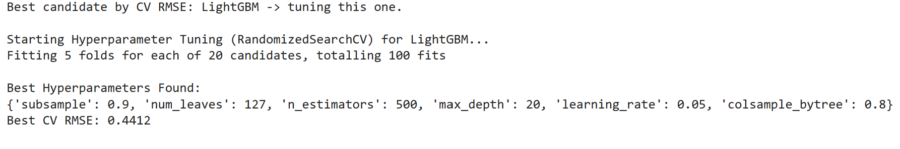
Final selected model
LightGBM — selected by lowest CV RMSE(0.4412), not assumed in advance

Slide 9
MODEL PERFORMANCE
Where the Model Performs Well
  Standard Suburban Homes: Highly accurate for typical, moderately priced houses.
  Balanced Predictions: Near-zero mean residual, showing no systematic over- or under-prediction overall.
Where the Model Performs Poorly
  Target Capping: Struggles with ultra-luxury homes due to the dataset's hard ceiling at $500,001.
  Coastal Outliers: Higher errors in crowded coastal and high-income areas due to extreme price variations.

Slide 10
MODEL EVALUATION
MAE
0.280
RMSE
0.432
Residual R²
0.858

Slide 11
WHY THESE METRICS?
  Continuous Target: The target variable (MedHouseVal) is a continuous number, making this a regression problem.
  MAE: Measures the average absolute error in real dollar terms.
  RMSE: Penalizes larger prediction errors more heavily, highlighting big misses.
  Residual R²: Shows the proportion of variance explained by our model (goodness of fit).

Slide 12
Live Demonstration of ML Prediction Pipeline
1. Working Project
Load trained model: best_model.pkl
Model loaded using Joblib
Use the trained pipeline for prediction
2. Sample Input
8 features: MedInc, HouseAge, AveRooms, AveBedrms
Population, AveOccup, Latitude, Longitude
Sample values are entered into the prediction function
3. Prediction Process
Input → Validation → Preprocessing → ML Model → Prediction
Checks missing values and data types
Saved pipeline performs preprocessing
predict_house_price() generates the output

Slide 13
4.Predicted Output
Prediction: 2.71583
≈ $271,583
Average inference latency: 19.11 ms
5. Input Validation Demo
Set AveRooms = None
System detects invalid input
“Input contains missing values.”
6. Reliability Test
Same input tested twice
Both predictions: 2.71583
Shows consistent/reproducible output
7. Backup
Screenshot of successful prediction
Screenshot of invalid-input validation

Slide 14
9. Challenges & Improvements
🔴 Challenges
Missing / invalid input values
Correct 8-feature format
Prediction consistency
Inference latency
Notebook execution issues
🟡 Solutions
Input validation
Saved preprocessing pipeline
Reproducibility testing
Latency benchmarking
Backup screenshots
🔵 Limitations
Depends on valid input data
Latency can vary by environment
Current demo is notebook-based
No separate interactive
application in reviewed section
🟢 Future Improvements
Interactive prediction application
Stronger validation
More data and testing
Better monitoring and logging

Slide 15
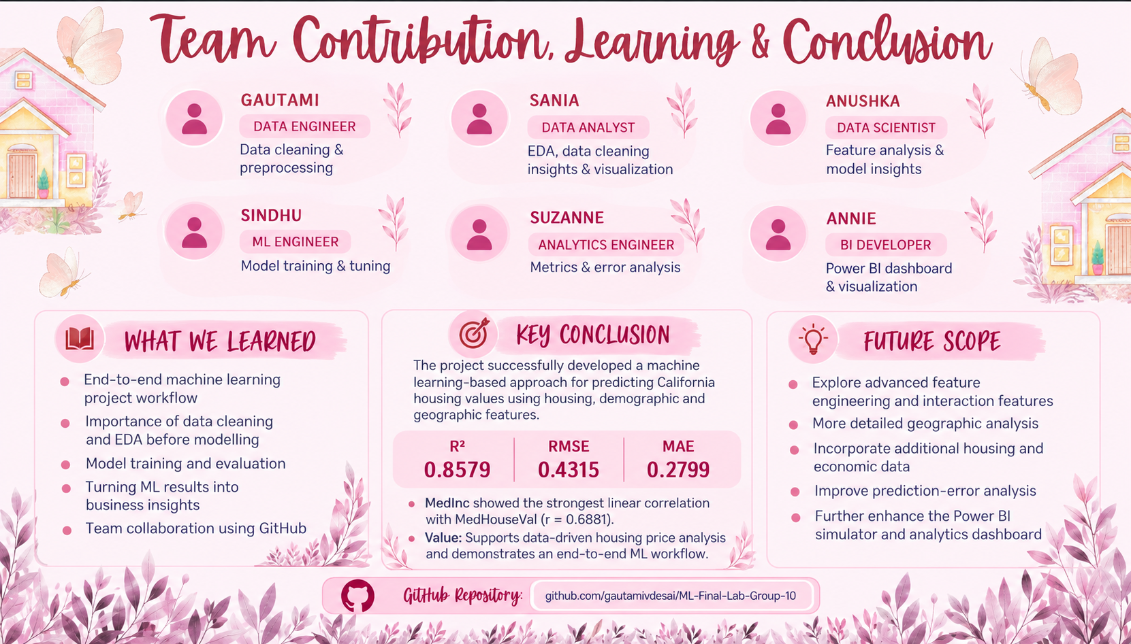

Slide 16


Thank You

Slide 17
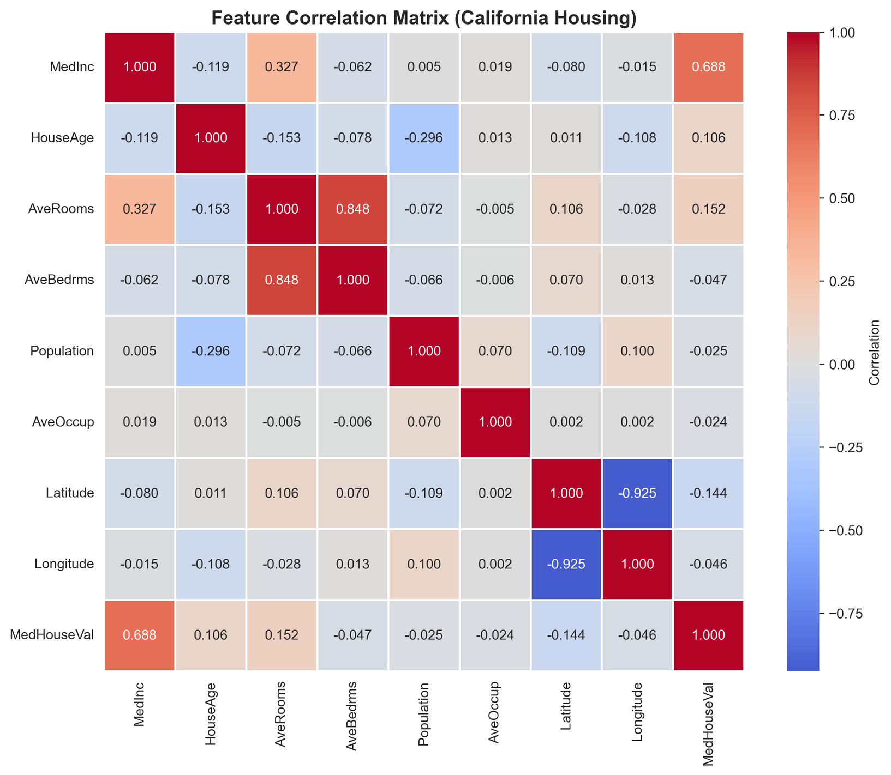

Slide 18
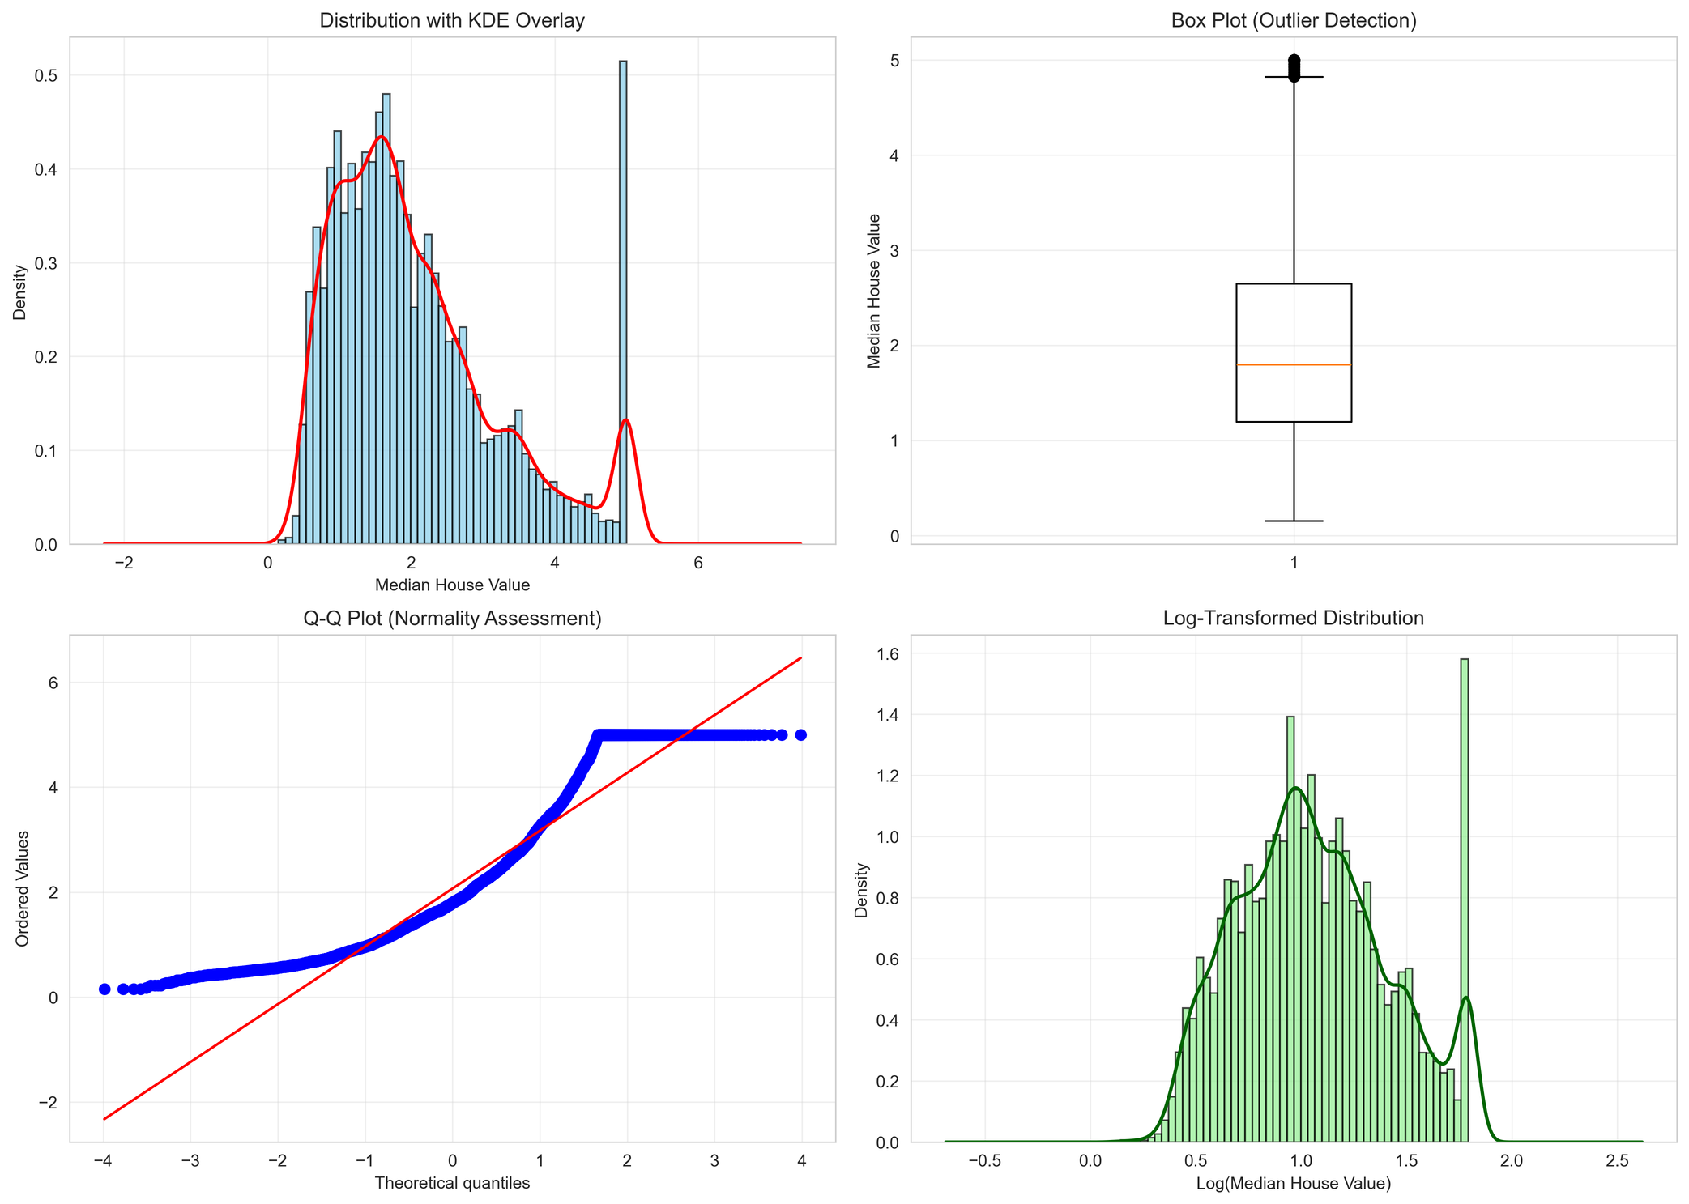

Slide 19
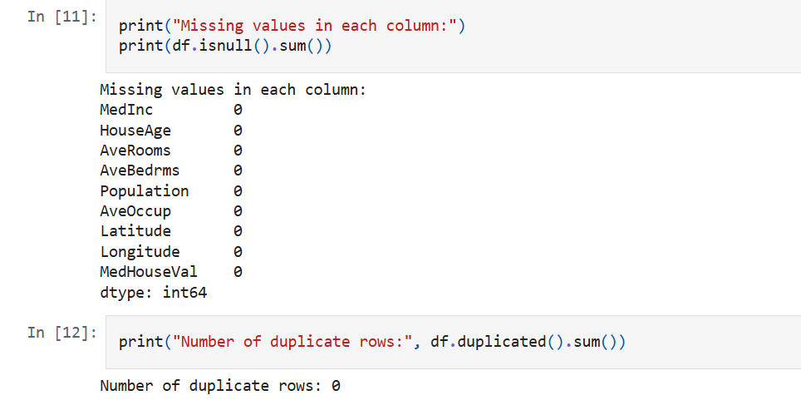
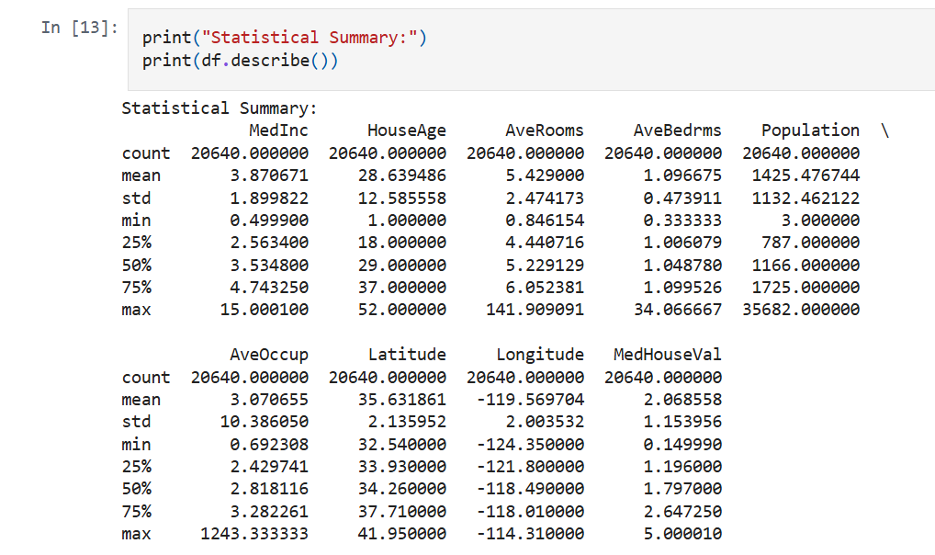

Slide 20
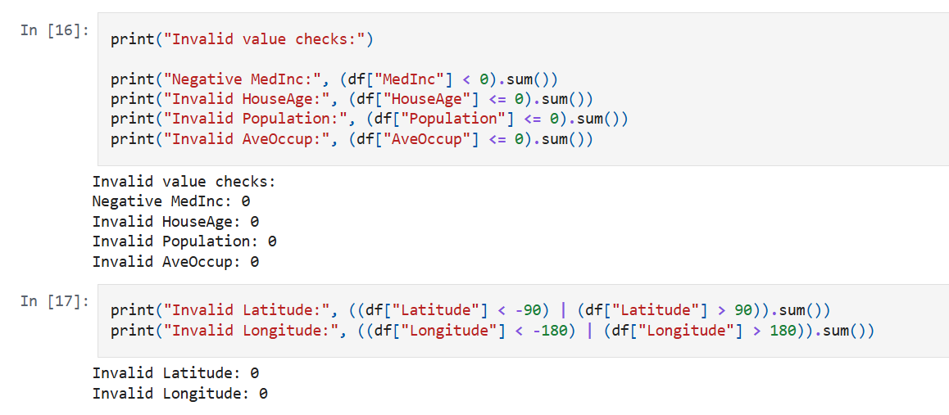
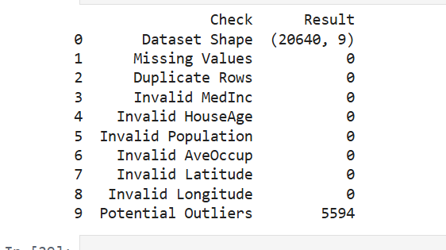

Slide 21
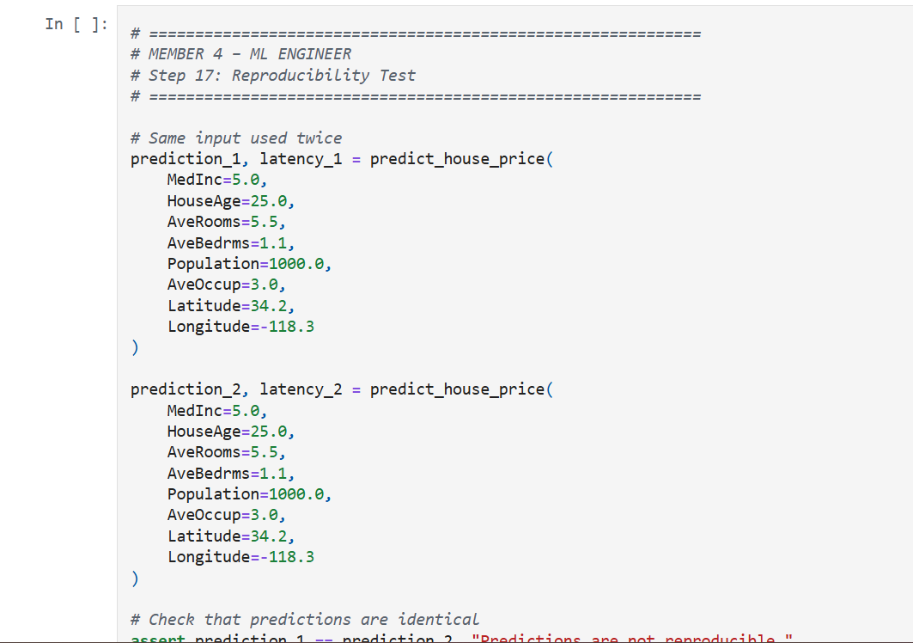

Slide 22
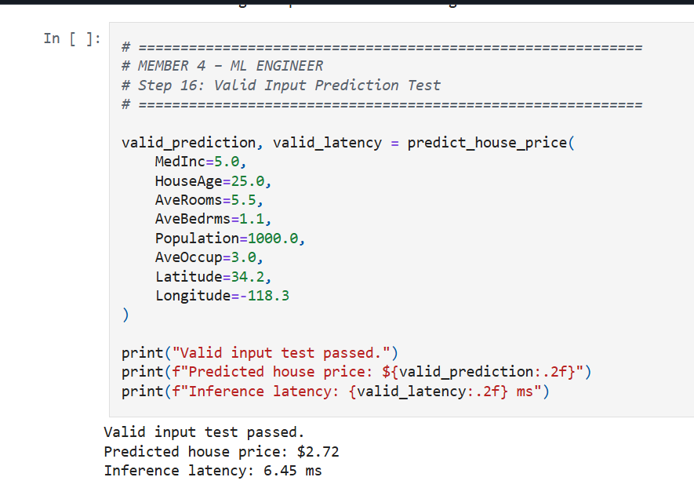

Slide 23
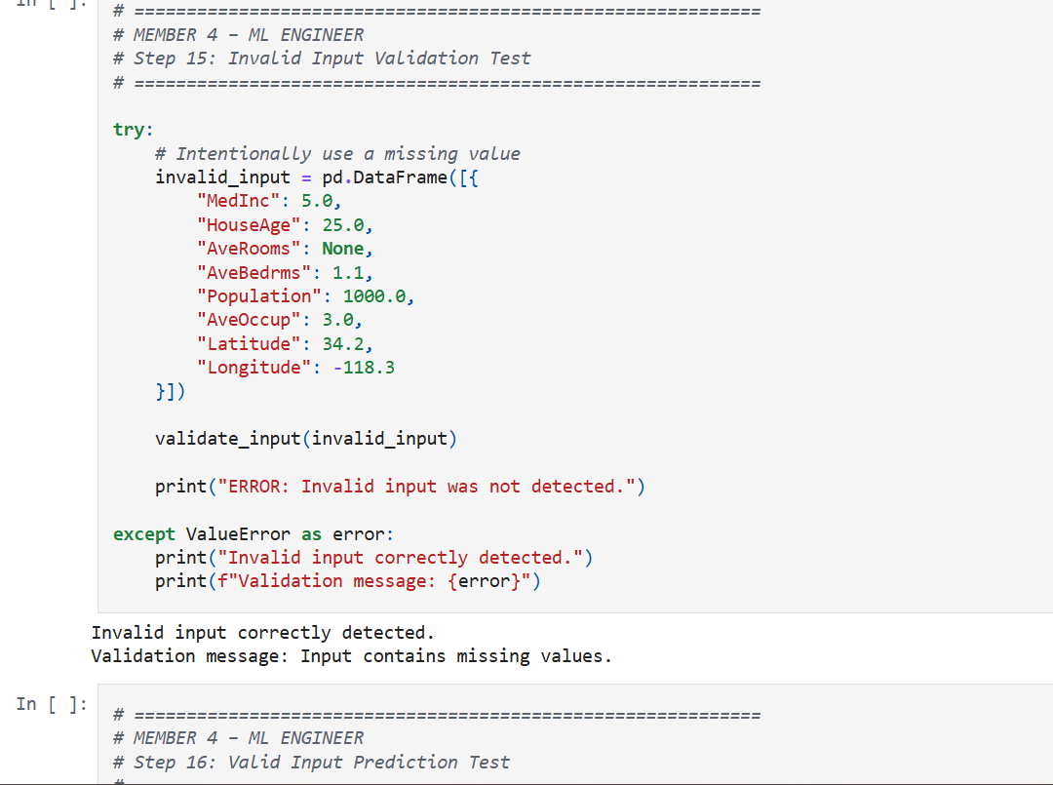

Slide 24
